Slide 1
WELCOME TO MAHCP
New member orientation

Slide 2
OUR MEMBERSHIP
85% of all allied health professionals working in Manitoba’s health-care system.
7,000+ specialized, highly-educated members in 45 distinct professions, 200+ classifications
Professional, technical and paramedical, delivering care and services in prevention, emergency response, diagnostics, assessment, treatment, recovery & rehabilitation
Employed throughout Manitoba in virtually all health-care settings including hospitals, labs, clinics, long-term care, community

Slide 3
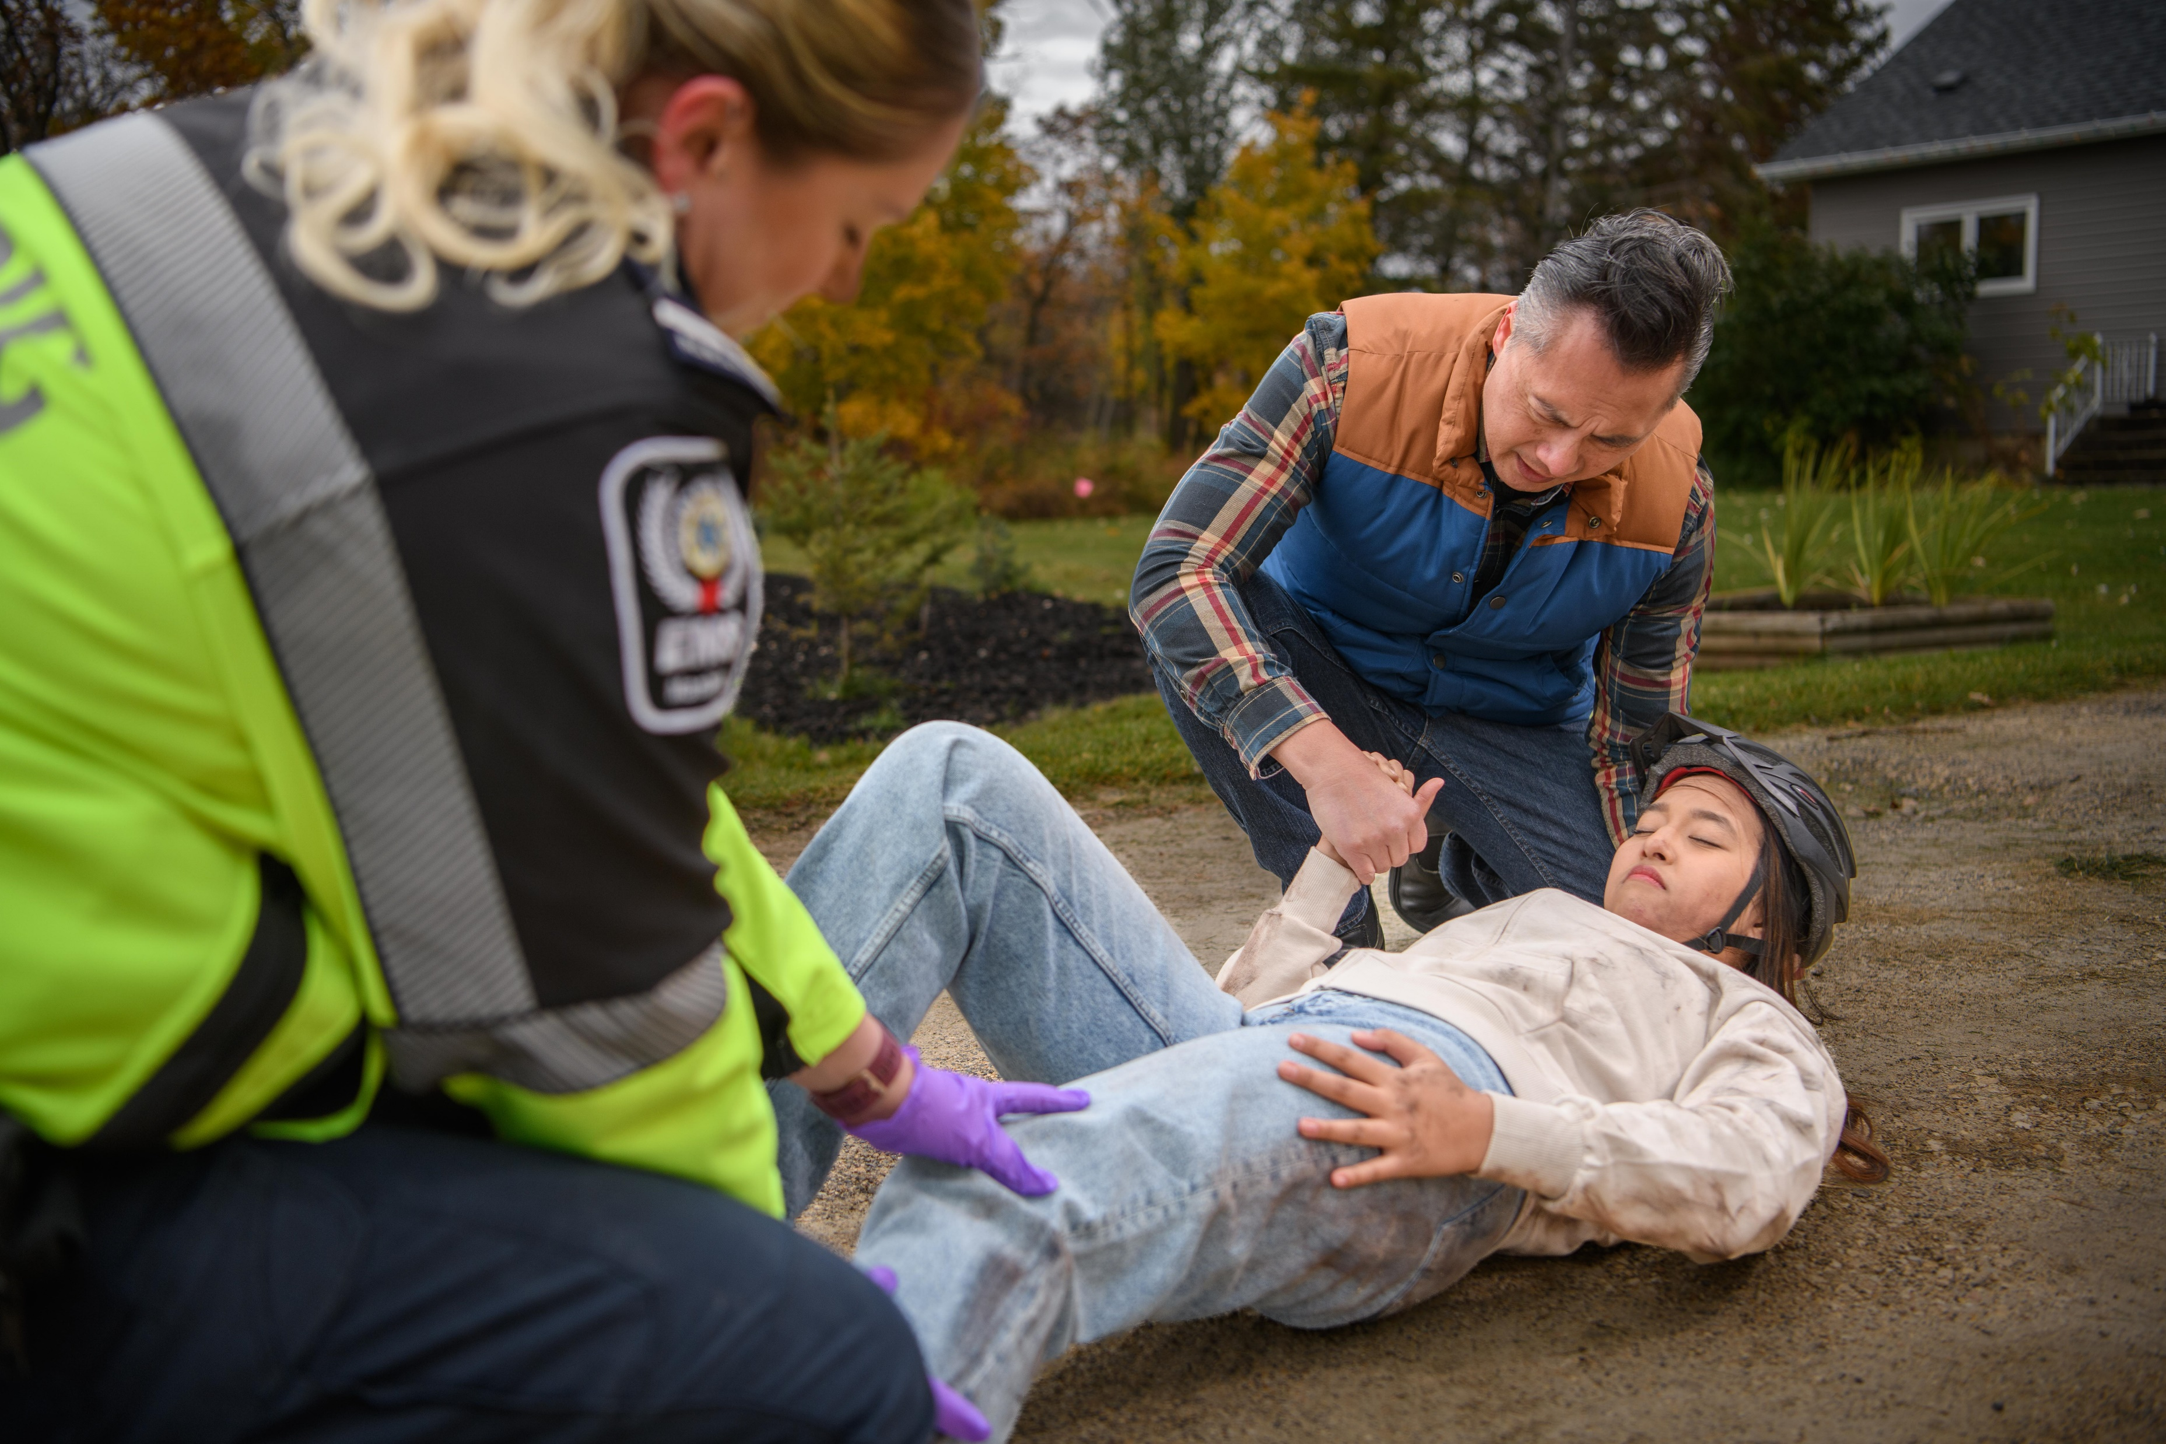
WE ARE DIFFERENT.
Only union in Manitoba solely dedicated to professional/technical and paramedical members.
More than 50 years of experience representing health-care professionals
Direct service model
Labour Relations Officers (LRO) – your first point of contact
Onsite, volunteer Member Advocates to assist you
Governed by an Executive Council made up of health-care professionals elected from 16 districts across Manitoba

Slide 4
HOW WE SUPPORT YOU
Negotiating for better wages and benefits, improved working conditions
Strong collective bargaining: advocating for competitive wages, enhanced benefits and working conditions
Knowledgeable representation: speaking out on your behalf, championing workplace concerns and issues
Saving you $: Exclusive discounts for members, professional development fund & scholarships
Keeping you informed: Union news, member features, bargaining updates

Slide 5
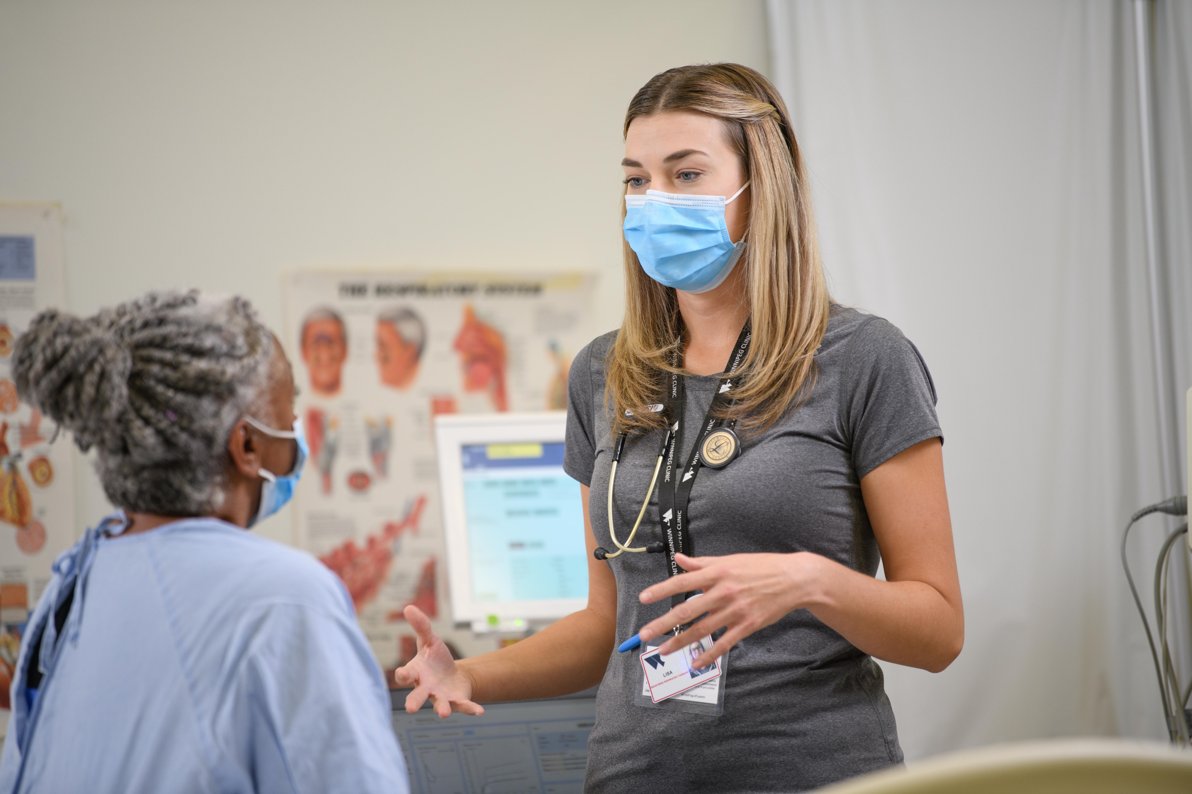
WHY MAHCP
Lowest member-to-LRO ratio of any competitor union in Manitoba
In-house legal counsel with extensive experience in policy and individual grievance filing and arbitration
One Member One Vote – AGMs are not delegated, any member can attend and have a voice
Council comprised entirely of health-care professionals, who understand the challenges facing our sector
First union to secure maternity leave top-up for members
Service mobility agreements between bargaining units and regions

Slide 6
ADVOCACY
Member Advocacy - Frontline worksite volunteers you can consult with labour questions and concerns
Workplace Health & Safety Committees
Employee Management Advisory Committees to address emerging worksite issues
Ongoing member mobilization and government relations to strengthen allied health professions for the future

Slide 7
INVESTMENT & BENEFITS
1.25% of your gross earnings, automatically deducted from your pay
Dues support collective bargaining, representation for you and your colleagues, grievance filing & investigation, legal research, arbitration
Members in Good Standing may:
Speak & vote at the AGM
Hold elective office
Volunteer for committees

Slide 8
PROFESSIONAL DEVELOPMENT
Continuing education for members
Up to three (3) $1,500 scholarships/yr open to MAHCP Members in Good Standing to upgrade/certify
Scholarships
Up to three (3) $500 scholarships/yr for Manitoba residents entering 1st year training in allied health
Up to 12 (twelve) $500 scholarships/yr to children of MAHCP Members in Good Standing, entering 1st year, full-time post-secondary in any field

Slide 9
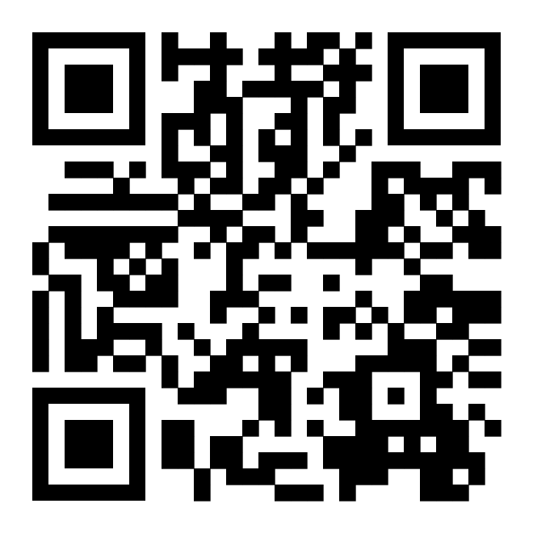
MEMBER SAVINGS
Leisure & fitness
Sports & arts events
unionsavings.ca
Many local businesses across Manitoba (and growing!)
Scan the QR code to complete the New Member Profile form. We’ll send you a handy Member ID card to take advantage of rebates.

Slide 10
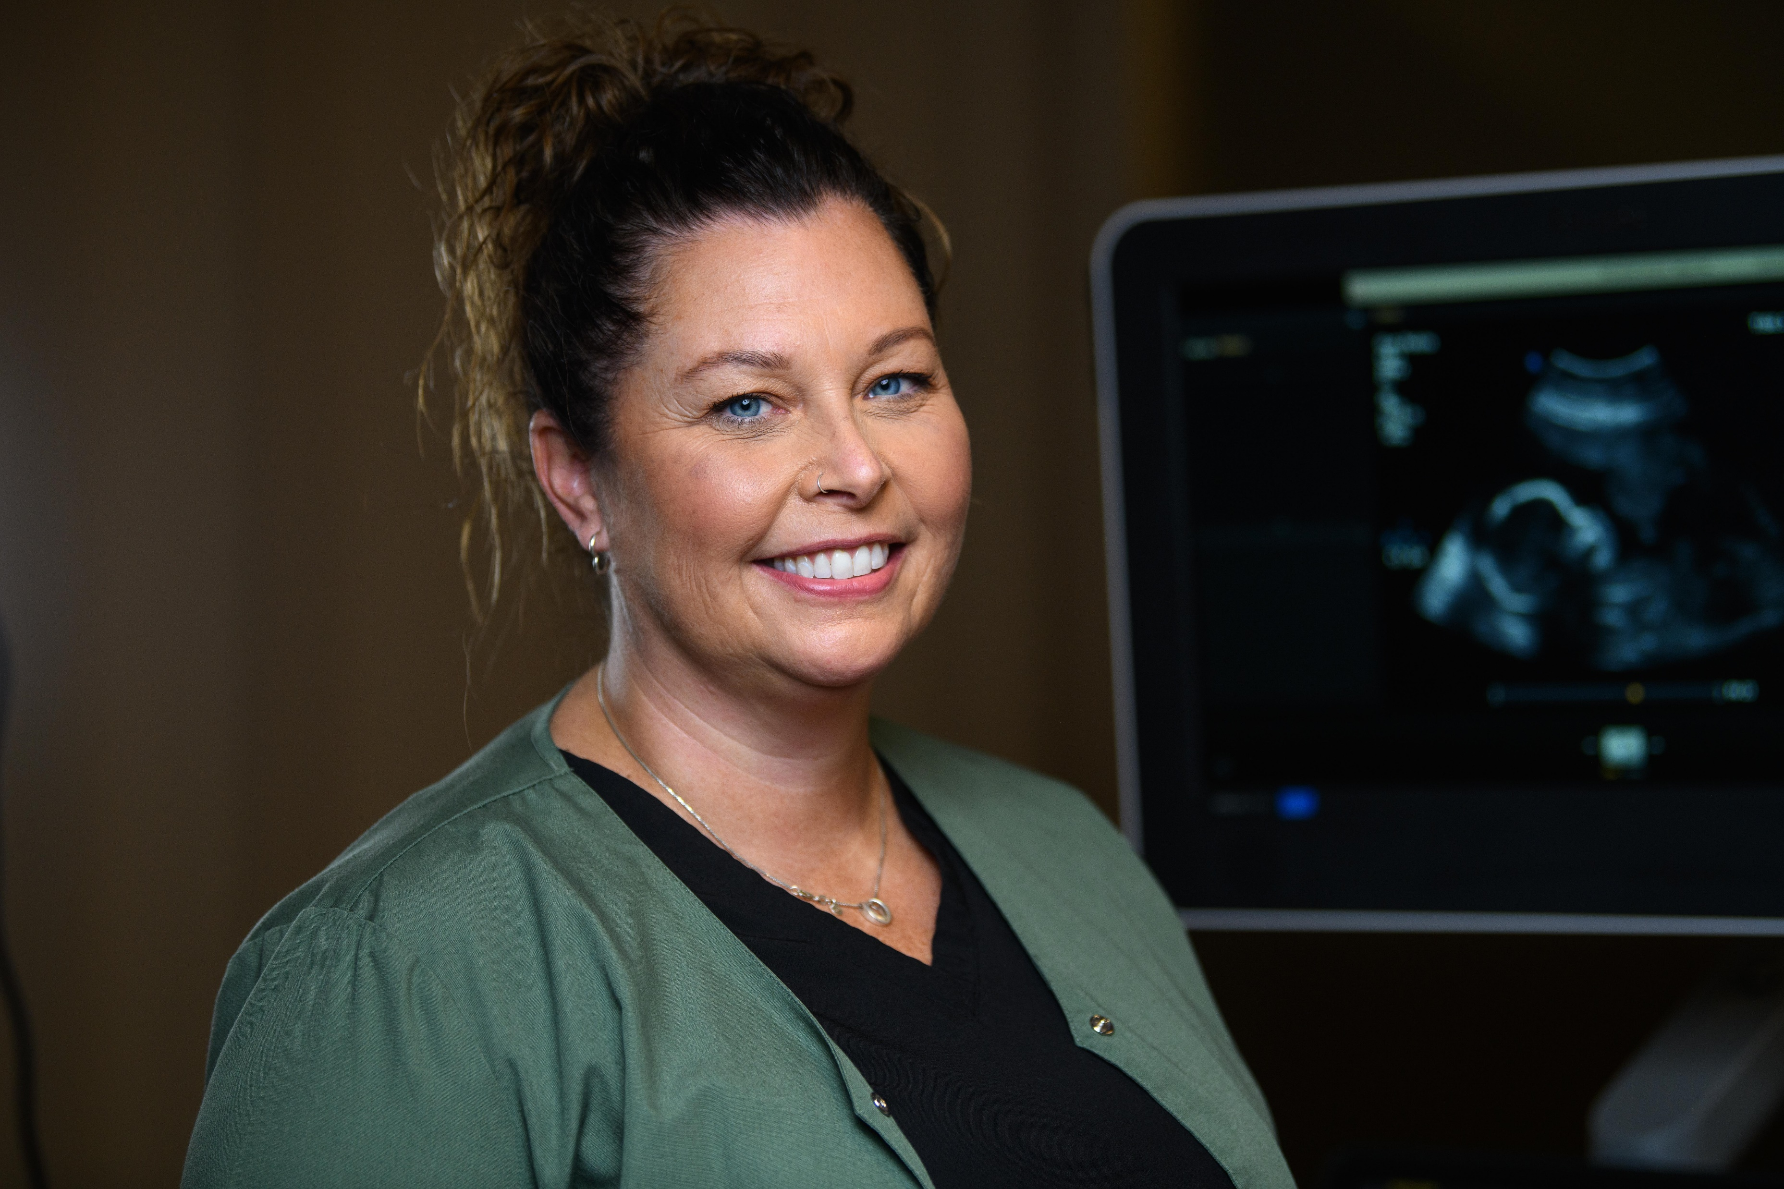
GET INVOLVED
Participate in virtual meetings, town halls
Fill out MAHCP member surveys
Submit proposals for bargaining
Volunteer as a Member Advocate
Represent your peers on MAHCP Executive Council/committees

Slide 11
STAY CONNECTED
Explore our site: www.mahcp.ca
Create a Member Portal account to access exclusive member news & updates
Stay tuned to email for member updates and newsletters
Follow MAHCP on social media

Slide 12
CONTACT US:
101-1500 Notre Dame Avenue
Winnipeg, MB R3E 0P9
T: 204-772-0425
E: info@mahcp.ca
www.mahcp.ca/findmylro/

